Slide 1

Programming WCF 3 Services
- Govardhan Reddy D N
Royal Sapphire Edu
Prog WCF 3
Appendix
Publisher
Online

Slide 2
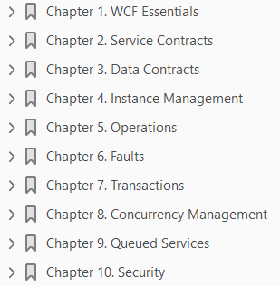
Programming WCF 3
Book Name: Programming WCF 3 Services 02 2007
Book Source:

Slide 3
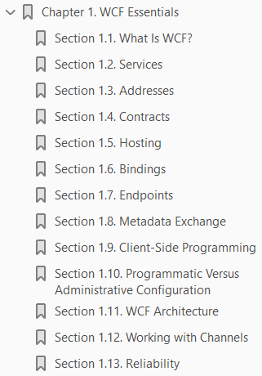
WCF Essentials
1

Slide 4
Intro
This chapter describes the essential concepts and building blocks of WCF and its architecture, enabling you to build simple services.
You will learn the basic terms regarding addresses, bindings, contracts, and endpoints; see how to host a service, learn how to write a client; and understand some related topics, such as in-proc hosting and reliability.
Even if you are already familiar with the basic concepts of WCF, I recommend you give this chapter at least a cursory reading, not only to ensure you have a solid foundation, but also because some of the helper classes and terms introduced here will be used and extended throughout the book.

Slide 5
What Is WCF?
Windows Communication Foundation (WCF) is an SDK for developing and deploying services on Windows.
WCF provides a runtime environment for your services, enabling you to expose CLR types as services, and to consume other services as CLR types.
Although in theory you could build services without WCF, in practice building services is significantly easier with WCF.
WCF is Microsoft's implementation of a set of industry standards defining
service interactions
type conversion
marshaling
various protocols' management
Because of that, WCF provides interoperability between services. WCF provides developers with the essential off-the-shelf plumbing required by almost any application, and as such, it greatly increases productivity.
The first release of WCF provides many useful facilities for developing services, such as
Hosting
service instance management

Slide 6
What Is WCF? |
asynchronous calls
Reliability
transaction management
disconnected queued calls
security
WCF also has an elegant extensibility model that you can use to enrich the basic offering.
In fact, WCF itself is written using this extensibility model.
The rest of the chapters in this book are dedicated to those aspects and features.
Most all of the WCF functionality is included in a single assembly called System.ServiceModel.dll in the System.ServiceModel namespace.
WCF is part of .NET 3.0 and requires .NET 2.0, so it can only run on operation systems that support it.
Presently this list consists of Windows Vista (client and server), Windows XP SP2, and Windows Server 2003 SP1 or their later versions.

Slide 7
Services
A service is a unit of functionality exposed to the world.
In that respect, it is the next evolutionary step in the long journey from functions to objects to components to services.
Service-orientation (SO) is an abstract set of principles and best practices for building SO applications.
If you are unfamiliar with the principles of service-orientation, Appendix A provides a concise overview and motivation for using service-orientation.
The rest of this book assumes you are familiar with these principles.
A service-oriented application (SOA) aggregates services into a single logical application similar to the way
a component-oriented application aggregates components or
an object-oriented application aggregates objects
as shown in Figure 1-1.
The services can be local or remote, developed by multiple parties using any technology, versioned independently, and even execute on different timelines.
Inside a service, you will find concepts such as languages, technologies, platforms, versions, and frameworks, yet between services, only prescribed communication patterns are allowed.

Slide 8
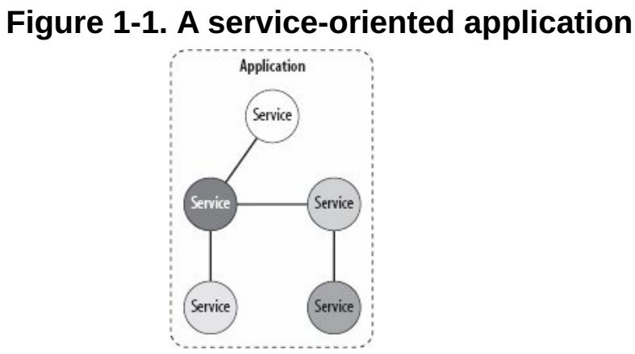
Figure 1-1

Slide 9
Exploring Service
The client of a service is merely the party consuming its functionality.
The client can be literally anything a Windows Forms class, an ASP.NET page, or another service.
Clients and services interact by sending and receiving messages.
Messages may transfer directly from client to service or via an intermediary.
With WCF, all messages are SOAP messages. Note that the messages are independent of transport protocols unlike Web services, WCF services may communicate over a variety of transports, not just HTTP.
WCF clients may interoperate with non-WCF services, and WCF services can interact with non-WCF clients.
That said, typically if you develop both the client and the service, you could construct the application so that both ends require WCF to utilize WCF-specific advantages.
Because the making of the service is opaque from the outside, a WCF service typically exposes metadata describing the available functionality and possible ways of communicating with the service.
The metadata is published in a predefined, technology-neutral way, such as using WSDL over HTTP-GET, or an industry standard for metadata exchange.
A non WCF client can import the metadata to its native environment as native types.
Similarly, a WCF client can import the metadata of a non-WCF service and consume it as native CLR classes and interfaces.

Slide 10
Services' Execution Boundaries
With WCF, the client never interacts with the service directly, even when dealing with a local, in-memory service.
Instead, the client always uses a proxy to forward the call to the service.
The proxy exposes the same operations as the service, plus some proxy-management methods.
WCF allows the client to communicate with the service across all execution boundaries.
On the same machine (see Figure 1-2), the client can consume services in the
same app domain
across app domains in the same process, or
across processes
Across machine boundaries (Figure 1-3), the client can interact with services in its intranet or across the Internet.

Slide 11
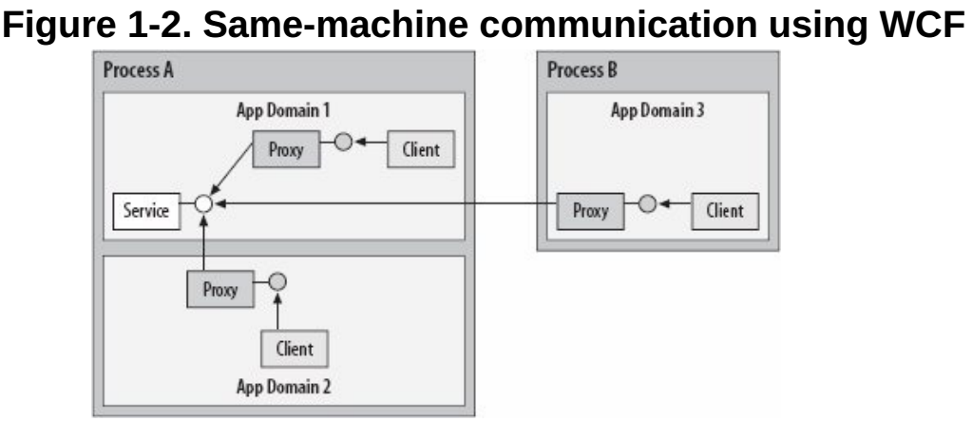
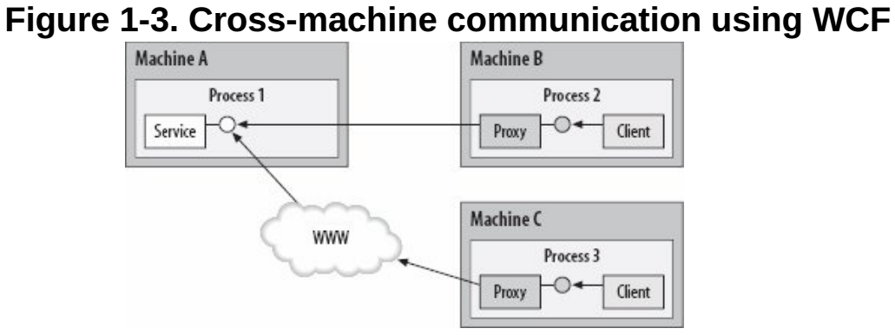
Figure 1-2 || 1-3

Slide 12
WCF and location transparency
In the past, distributed computing technologies such as DCOM or .NET Remoting aspired to provide the same programming model to the client whether the object was local or remote.
In the case of a local call, the client used a direct reference, and when dealing with a remote object, the client used a proxy.
The problem with this approach of trying to take the local programming model and make it the remote programming model is that there is much more to a remote call than an object with a wire.
Complex issues such as life cycle management, reliability, state management, scalability, and security raised their heads, making the remote programming model significantly more complex, all because it tried to be what it is not - a local object.
WCF also strives to provide the client with the same programming model regardless of the location of the service.
However, the WCF approach is the exact opposite: it takes the remote programming model of instantiating and using a proxy and uses it even in the most local case.
Because all interactions are done via a proxy, requiring the same configuration and hosting, WCF maintains the same programming model for the local and remote cases; thus it not only enables you to switch locations without affecting the client, but also significantly simplifies the application programming model.

Slide 13
Addresses
In WCF, every service is associated with a unique address.
The address provides two important elements:
the location of the service
the transport protocol or transport schema used to communicate with the service
The location portion of the address indicates the name of the target machine, site, or network; a communication port, pipe, or queue; and an optional specific path or URI.
A URI is a Universal Resource Identifier, and can be any unique string, such as the service name or a GUID.
WCF 1.0 supports the following transport schemas:
HTTP TCP Peer network IPC (Inter-Process Communication over named pipes) MSMQ
Addresses always have the following format:
The base address is always in this format:

Slide 14
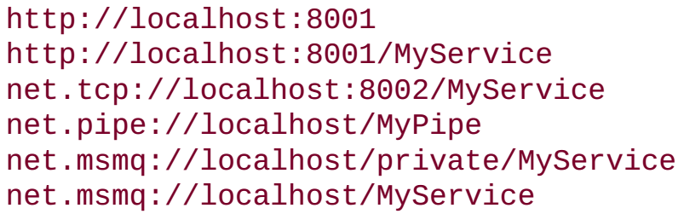

Addresses |
Here are a few sample addresses:
The way to read an address such as
is like this: "Using HTTP, go to the machine called localhost, where on port 8001 someone is waiting for my calls."
If there is also a URI such as:
then the address would read as follows: "Using HTTP, go to the machine called localhost, where on port 8001 someone called MyService is waiting for my calls."

Slide 15
TCP Addresses

Slide 16
HTTP Addresses

Slide 17
IPC Addresses

Slide 18
MSMQ Addresses

Slide 19
Peer Network Address

Slide 20
Contracts

Slide 21
Hosting

Slide 22
Bindings

Slide 23
EndPoints

Slide 24
Metadata Exchange

Slide 25
Client-Side Programming

Slide 26
Programmatic Versus Administrative Configuration

Slide 27
WCF Architecture

Slide 28
Working with Channels

Slide 29
Reliability

Slide 30
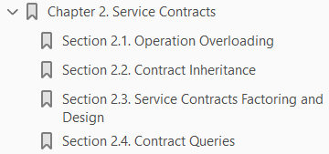
Service Contracts
2

Slide 31
Intro

Slide 32
3

Slide 33
Intro

Slide 34
4

Slide 35
Intro

Slide 36
5

Slide 37
Intro

Slide 38
6

Slide 39
Intro

Slide 40
7

Slide 41
Intro

Slide 42
8

Slide 43
Intro

Slide 44
9

Slide 45
Intro

Slide 46
10

Slide 47
Intro

Slide 48
Appendix

